Slide 1
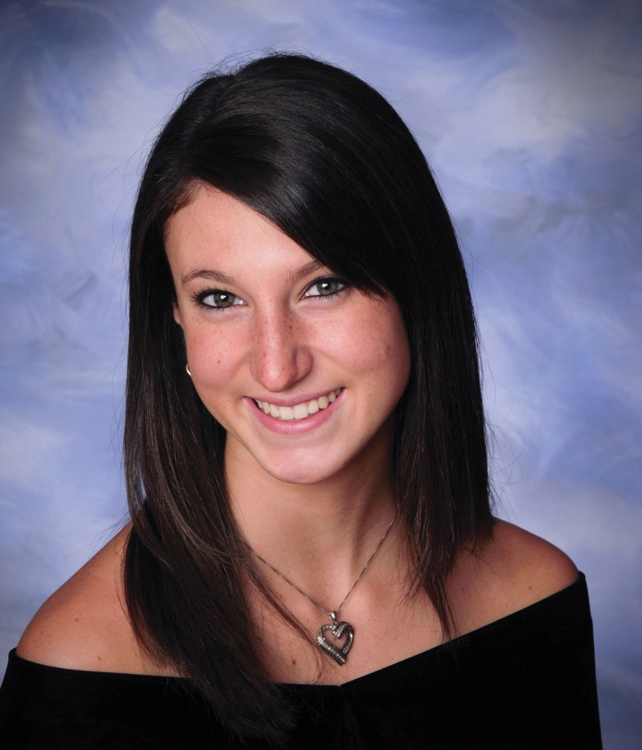
MEET KIM AND EMILY
Why Meningitis B
Vaccination Matters
Add your
college logo

Slide 2
MEET KIM AND EMILY
Meningitis B is more prevalent among young adults and college students.
Emily, 19
College sophomore Emily, died from Meningitis B 36 hours after her first symptoms.
Kim, 17
Kimberly, 17, died one week before her high school graduation from Meningitis B.

Slide 3
WHAT IS BACTERIAL MENINGITIS?
A
B
C
W
Y
Let’s start with the basics.
Meningitis is an inflammation (swelling) of the protective membranes covering the brain and spinal cord.
There are 5 different types of meningitis – bacterial, viral, parasitic, fungal, and non-infectious.
Meningococcal meningitis is the most common form of bacterial meningitis among young adults.
It is mainly caused by 5 types of meningococcal bacteria: ABCWY. Meningitis B is caused by the B meningococcal bacteria.

Slide 4
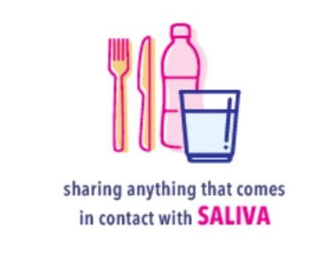
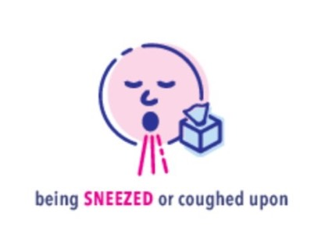
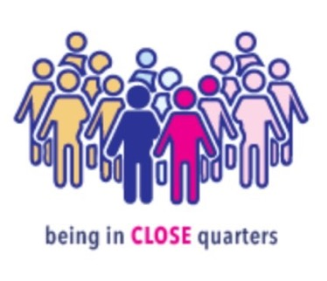
HOW CAN I GET IT?
It can be easy to spread from person-to-person.

Slide 5
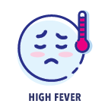
IT CAN COME OUT OF NOWHERE.
Symptoms to look out for.
It can attack without warning.
Early symptoms can often be mistaken for the flu or a bad hangover.
In some cases, you may be infected with Meningitis B, but asymptomatic (not presenting any symptoms).

Slide 6
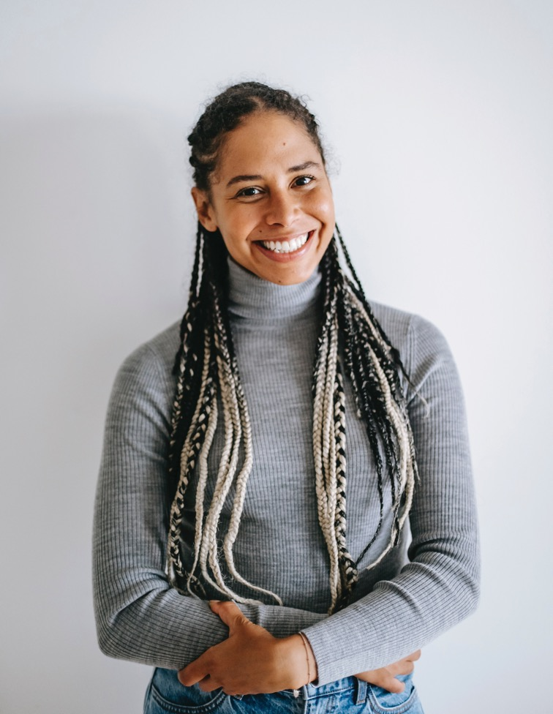
MENINGITIS B IS 5X MORE COMMON AMONG COLLEGE STUDENTS.
One of the scariest things about Meningitis is that it can kill quickly. You can go from studying in your room one night to being in a coma less than 48 hours later.
It can also cause severe permanent complications, including brain damage, hearing loss, learning disabilities, or even limb amputations.
But there is something you can do about it!

Slide 7
VACCINES ARE THE MOST EFFECTIVE WAY TO PROTECT YOURSELF AGAINST MENINGOCOCCAL MENINGITIS.
You need two types of meningitis vaccines to help protect yourself.
Both vaccines are CDC-recommended.
Many colleges require the MenACWY vaccine for enrollment, but few require the MenB vaccine.

Slide 8
WHAT CAN YOU DO?
First, check if our health center offers the MenB vaccine.
If not, talk to your parents about making an appointment to get vaccinated by your family doctor or at a local pharmacy next time you go home.
Remember, you need to ask your healthcare provider if you’ve had both the MenACWY and MenB vaccine.
Avoid sharing items with friends when possible, and…
Pass it on…!

